Slide 1


ModelWriter Text & Model-Synchronized Document Engineering Platform
Project Leader: Ferhat Erata (ferhat@computer.org)
Project Email: project@modelwriter.eu
Notes:
Hello everyone, I’d like to begin by thanking you all for coming today.
My name is [Ferhat Erata] from [UNIT Information Technologies Research & Development].
I am the project leader of ModelWriter project.
Before starting the presentations, I would like to specially thank Anne for hosting the meeting.
I would like to invite review chairman to make the introductory speech for today’s review.
The graphics on this slide is a mock-up that shows what was envisioned before starting off the project. This demonstrates two aspects of ModelWriter. At the RHS is the writer part and at LHS is the model part. The main ambition is to come up with an idea to synchronize arbitrary software and engineering artefacts.
If you look at the details, the synchronization is maintained behind the scene.
1

Slide 2
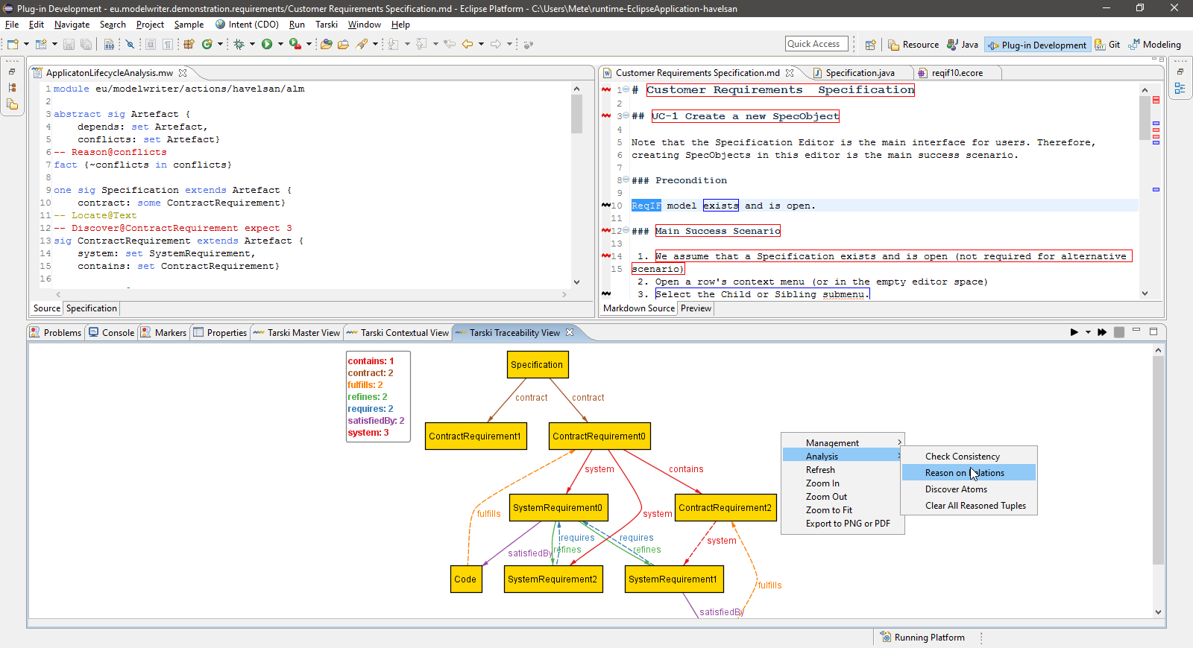
ModelWriter Text & Model-Synchronized Document Engineering Platform
Project Leader: Ferhat Erata (ferhat@computer.org)
Project Email: project@modelwriter.eu
Notes:
The latter one, this one, clearly shows that we achieved the goal of having a working User Interfaces on Eclipse platform. That was what we anticipated. In addition to that, we provide a view at the bottom to visualize the those traceability links between artefacts or part of artefacts.
2

Slide 3
1 Introduction
Ferhat Erata
UNIT, ModelWriter Project Leader
Notes:
Let me introduce the partners attends today’s meeting. I have already introduced myself.
Let’s begin with CNRS/LORIA, Prof. Claire, could you introduce yourself and your research organization…
3

Slide 4








Participants ModelWriter #1 Review
Ferhat Erata
Dr. Moharram Challenger
Hasan Emre Kirmizi
Yvan Lussaud
Etienne Juliot
Dr. Eray Tuzun
Yagup Macit
Tuğçe Yiğiter
Alan Endersoy
Dr. Emrah Kinav
Dr. Guven Köse
Omurhan Soysal
Aydin Can Polatkan
Dr. Claire Gardent
Dr. Samuel Cruz-Lara
Dr. Bikash Gyawali
Anastasia Shimorina
Dr. Geylani Kardas
Mehmet Onat
Hale Gezgen
Ersan Gürdoğan
Taskin Kızıl
Oguz Yavuz
Dr. Anne Monceaux
Notes:
Let me introduce the partners attends today’s meeting. I have already introduced myself.
Let’s begin with CNRS/LORIA, Prof. Claire, could you introduce yourself and your research organization
4

Slide 5
Agenda [13:00 - 17:00]
Introduction (5 mins) [13:00 - 13:05]
Overview of the project (WP5) (15 min) [13:05 - 13:20]
Industrial Use Cases (WP1) (30 min) [13:20 - 13:50]
Exploitation Related Activities (WP7) (10 mins) [13:50 - 14:00]
Technical Innovations (WP2, 3 & 4) (30 mins) [14:00 - 14:30]
User Interfaces & Integration (WP6) (10 mins) [14:30 - 14:40]
Break (20 mins) [14:40 - 15:00]
Demonstrations (60 mins) [15:00 - 16:00]
Conclusions (10 mins) [16:00 - 16:10]
Reviewers’ Private Section (30 min) [16:10 - 16:40]
Feedback Session (15min) [16:40 - 16:55]
Final Words (5 min) [16:55 - 17:00]
Notes:
We’ve planned an intense schedule for today. Presentation is divided into 5 main sections.
First I will make an overview of the project.
Second, Anne from Airbus will moderate the industrial use cases segment. Based on your feedbacks made after the first review, we made a decision to focus on the most rewarding use cases that are stemmed from the problems faced by our large industrial partners. Therefore, Airbus, Ford-Otosan and Havelsan will present their use cases. In each use case, we will describe Technical Challenges and corresponding KPIs.
Third, once you get familiar with the problem domain, we will explain the market of ModelWriter and our exploitation prospects.
Fourth, we’ll describe technical achievements attained for each technical work package, which means will focus on innovations in this section. What we accomplished beyond the SotA and innovations in tackling the challenges. We will try to convince you that ModelWriter is an effective remedy for this set of problems.
Finally, we will demonstrate what we achieved in the industrial use cases. We will make three demonstrations for Airbus, Havelsan and Ford Otosan.

Slide 6
2 Overview of the Project
Ferhat Erata
UNIT, ModelWriter Project Leader

Slide 7
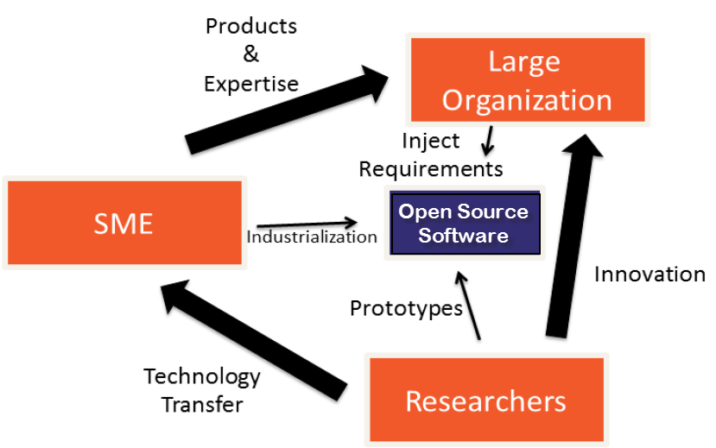



Industrialization Triangle in ModelWriter Open Source Software (year #1)
Industrial Use Cases
Success Stories
Long Term Agreements
ModelWriter
New Product & Services
Commercialization
Open Source Software
Standardization
New Standard or Standard Extension
Publications, Open Source Software
Notes:
If you look at this Figure, you will see ModeWriter’s industrialization triangle.
ModelWriter is an Open-Source Software Platform and partners positioned around them.
We transfer the knowledge in university to industry which they develope theory and prototypes.
by means of combining the expertise of SMEs of the consortium (in our case, eclipse)
In this triangle, Large Organizations (most of their dominant core business is not developing software related services) provides the industrial expertise and define requirements
SMEs commercialize the solutions in the market as products.
We initially positioned on the triangle as shown here.

Slide 8

Industrialization Triangle in ModelWriter Open Source Software (year #2)
Industrial Use Cases
Success Stories
Long Term Agreements
ModelWriter
New Product & Services
Commercialization
Open Source Software
Standardization
New Standard or Standard Extension
Publications, Open Source Software
Notes:
After withdrawal of Belgian Consortium, we repositioned ourselves to be more effective and efficient.
KocSistem and Hisbim become tool providers. UNIT started a research program.
FordOtosan joined in the consortium as industrial use case provider.
We reduced the number of industrial cases that we’ve focused on to three domain, which are ALM and PLM from aerospace. automotive and military software business.

Slide 9
ModelWriter Today’s Knowledge Capture
Knowledge Capture with Word Processors
Document-centric,
Knowledge Capture with Modelling Tools
Model-centric, Structural and formal
Seamless Knowledge Capture with ModelWriter
ModelWriter as integrated product
Technical Documents
Natural Language
Modelling and Model Reasoning tools (= “Model” part),
and keeps both views seamlessly synchronized with each other.
Requirements, Specifications
Very Informal ones (mind maps, text tables, spreadsheets)
Formal ones (UML, SysML, EMF, BPMN …)
Text-based
Semantic Parser & Annotator (= “Writer” part)
Architectural Design Documents, 3D Design Models …
Program files
No formal semantics
Abstract Syntax Tree of Programs
Notes:
Let me introduce you the three pillar, or motivation, three main functionality of the project.

Slide 10
ModelWriter bi-directional Knowledge Capture tool

Slide 11
What is the problem?

Slide 12
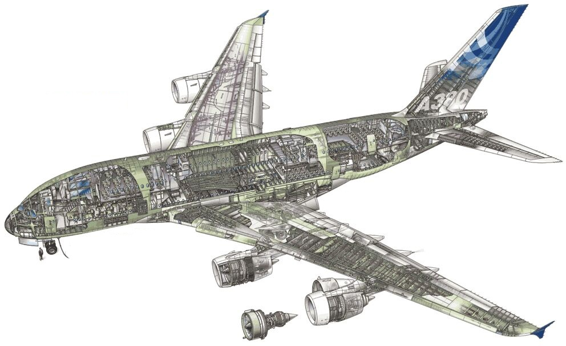
Industrial Use Case in Airbus
Synchronization of regulation documentation with a design rule repository

Slide 13
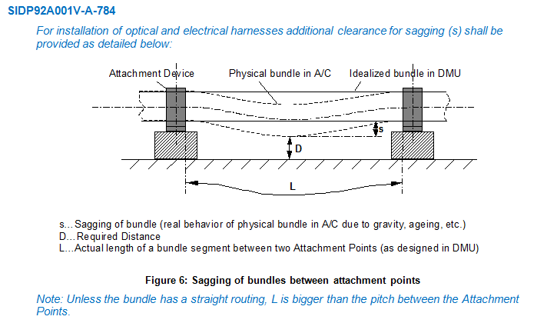
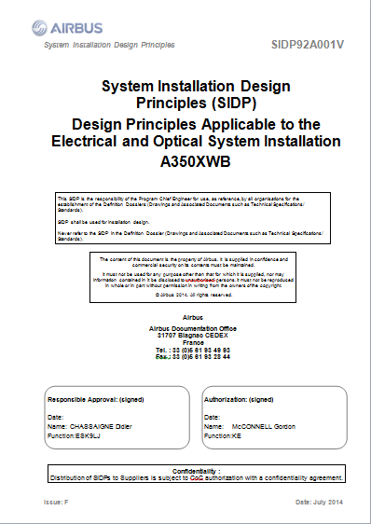
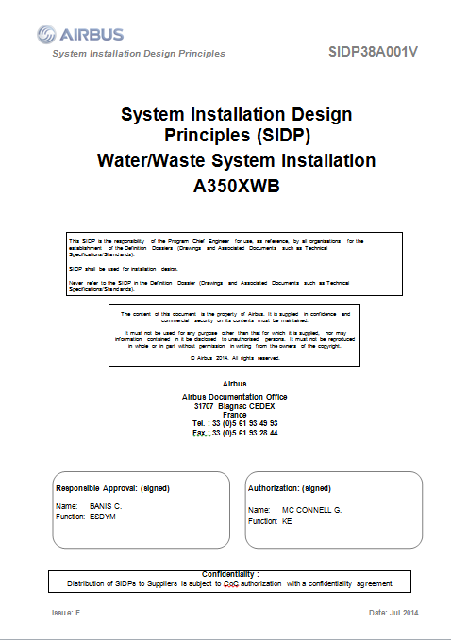
SIDP: System Installation Design Principles

Slide 14
Component Ontology and Rules
Objectives:
Manage rules/design principles and improve traceability
Automate identification of design conflicts against rules
ObjectProperties
Component
Assembly
“Structural_Element”
subClassOf
“Bracket”
Physical component
Attachment device
“Fastener”
“Pclamp”
Clamp
AnnotationProperties
Rdfs:label
“Assembly”
Skos:prefLabel
P-Clamp
“P-clamp NSA5516 can be fixed on X with Y”
P-Clamp NSA5516
“Physical component”
“Standard reference”

Slide 15
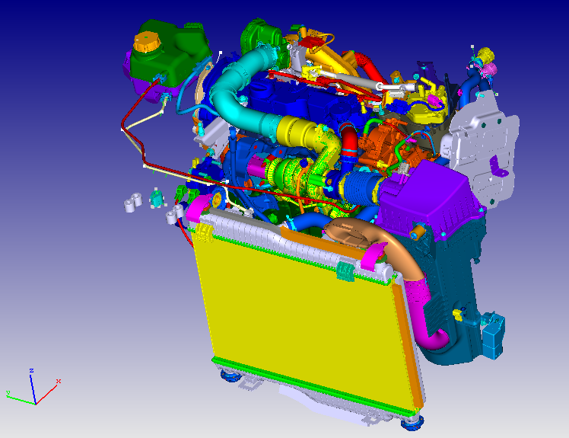
Industrial Use Case in Ford Otosan
Synchronization of Design Specifications with Computer Aided Design Data in Product Lifecycle Management

Slide 16
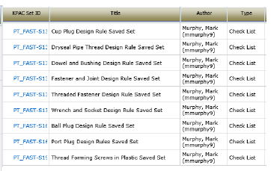
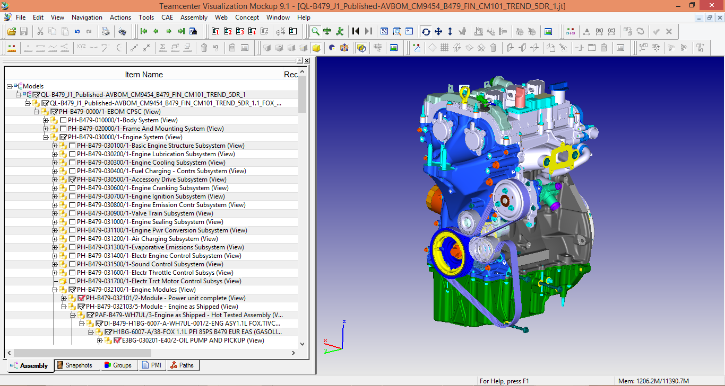
BOM and Design Specifications
“Design Rules”
“Bill of Material Data”
“Computer-aided Design Data”
Notes:
`

Slide 17
Industrial Use Case in Havelsan
Integration with Application Lifecycle Management to ensure reliability and consistency in the system under development.

Slide 18
Automated Analysis of Dynamically Configured Traceability Semantics
“Traceability Rules to define traceability semantics”
Artefacts or part of artefacts
“Various Traceability Analysis might be performed”
Notes:
SIDP is used (under Non Disclosure agreement) as a use case

Slide 19
Level of Collaboration within ModelWriter International Collaboration
Yvan Lussard
Ferhat Erata
Open Source Software (Eclipse Public License)
Eclipse Mylyn Intent Project Lead
ITEA2 ModelWriter Project Lead
AIRBUS SIDP Documentation
Dr. Claire Gardent
Life-cycle Traceability
Dr. Anne Monceaux
ITEA3-ASSUME Project
Dr. Eray Tuzun
Dr. Geylani Kardaş
Dr. Emrah Kınav

Slide 20


Level of Collaboration within ModelWriter International Collaboration
Prof. Hans Vangheluwe (Chair)
Dr. Anne Monceaux (MC)
MPM4CPS
Ferhat Erata (MC)
University of Antwerp (Grant Holder)
Modeling, Design & Simulation Lab.
Multi-Paradigm Modeling, Formalism Transformation,
Cyber-physical Systems
Software Engineering Research Lab
IC1404 Cost Action for Multi-Paradigm Modeling for Cyber-physical Systems

Slide 21
ModelWriter Work Packages & Technical Innovations
WP1 Industrial Use Cases and Requirements (AIRBUS)
WP3 (UNIT)
WP4 (MANTIS)
WP6 (OBEO)
WP2 (LORIA)
Semantic Parser & Annotator
Bi-directional synchronization mechanism between KB and models
A federated Knowledge Base and its API
A complete “ModelWriter” tool integrating of all these in a consistent way
Synchronization mechanism between texts/models & knowledge base
bi-directional transformation between text and formal knowledge (KB) representation
User Interfaces
Consistency checking and reasoning support
Configuration Components
Document Generation
Ergonomics
Semantic Data Model
WP5 Project Management (UNIT)
WP7 Standardization, Dissemination and Exploitation (OBEO)

Slide 22
ModelWriter Technological components & interactions

Slide 23

ModelWriter Simplified Architecture
Editor
Documents
(doc, docx, odt,textile,etc)
Text
Connectors
Text
Semantic
Module
KB
Model
Models Connectors
Model Integration
Module
Model
Models
Notes:
Simplified version of the actual architecture, there is a striking resemblance between planned and actual ones which means logical decomposition of project based on functions corresponds the real architecture.

Slide 24
ModelWriter Activities in the First Year https://github.com/modelwriter/workshops
The 1st International ModelWriter Workshop in Izmir, Turkey (Jan 15-17, 2015) [M4]
The 2nd International ModelWriter Workshop in Brussels, Belgium (Apr 30, 2015) [M7]
The 3rd International ModelWriter Workshop in Toulouse, France (Jun 22-23, 2015) [M10]
The 4th International ModelWriter Workshop in Brussels, Belgium (Sep 23-24, 2015) [M12]
The 1st International Eureka Project Exhibition in Berlin, Germany (Mar 10-11, 2015) [M6]
The 5th International ModelWriter Workshop in Ludwigsburg, Germany (Nov 2-5, 2015) [M16]
Project Kick-off in Istanbul, Turkey (Nov 08, 2014) [M1]
Initial Architectural Design, Indutrial Use Cases, Technical WP discussions
Collaboration Infrastructure
Exploitation: Havelsan’s participation
Consolidated User Requirements & Review
Software Requirements Review & Architecture
Rehearsal & Review
Integration of software components
Notes:
1.
2.
3.
4.
5.

Slide 25
ModelWriter Activities in the Second Year https://github.com/modelwriter/workshops
Product Owner Review Meeting
The 6th International ModelWriter Workshop in Paris, France (Feb 15-16, 2016)
ModelWriter Poster Presentation SAT/SMT/AR Summer School 2016
ICT Cost Action - MPM4CPS WG meeting at Vienna, Austria, on the 15-16 April, 2016
The 7th International ModelWriter Technical Workshop in Toulouse, France (6 June 2016)
The 7th Int’l ModelWriter Brainstorming Session in Toulouse, France at Airbus (9 June 2016)
The 7th Int’l ModelWriter Coordination Meeting in Toulouse, France at Airbus (10 June 2016)
Participation in International Joint Conference on Automated Reasoning (IJCAR) 2016
ModelWriter is positioned on the Working Groups of this Cost Action
Future of ModelWriter is discussed
Poster Presentation
Notes:
1.
2.
3.
4.
5.

Slide 26
ModelWriter Activities in the Second Year https://github.com/modelwriter/workshops
Verification Technology, Systems & Applications (VTSA) Summer School (Aug 29- Sept 02, 2016)
ICT Cost Action - MPM4CPS WG meeting at Gdansk, Poland (Sep 13-16, 2016)
A paper is submitted to ACM Applied Computing Symposium and under review.
The 8th International ModelWriter Technical Workshop in Toulouse, France (13 June 2016)
ICT Cost Action - MPM4CPS WG meeting at Malaga, Spain (Nov 24-25, 2016)
Participation in Workshop on Software Correctness and Reliability (Oct 7-8 2016)
Notes:
1.
2.
3.
4.
5.

Slide 27
Other topics
PCA is finalized and Turkish Partners signed the document.
The number of document deliverables are reduced.
Ford-Otosan joined in the consortium as a self-founded partner like Havelsan.
We focus on the use cases of Large Industrial Partners’ use cases.
Preparing a change request for reducing the number of deliverables.

Slide 28
Thank you for your attention We value your opinion and questions.

Slide 29
Progress on the Industrial Use Cases
Model Writer

Slide 30
WP1 overview
3 main use cases:
Airbus | Regulation documentation & Design rule repository
Havelsan | Requirement and ALM tool
Ford Otosan | Design specification with CAD (FEAD, GDR)
Project Review 1 Conclusions and Actions 2015:
Focus on the most rewarding use cases with the best exploitation prospects
Decrease MW ambition: reduce the effort on UC and put the effort on technical work packages

Slide 31
AIRBUS industrial use cases
Anne MONCEAUX
AIRBUS GROUP INNOVATIONS

Slide 32
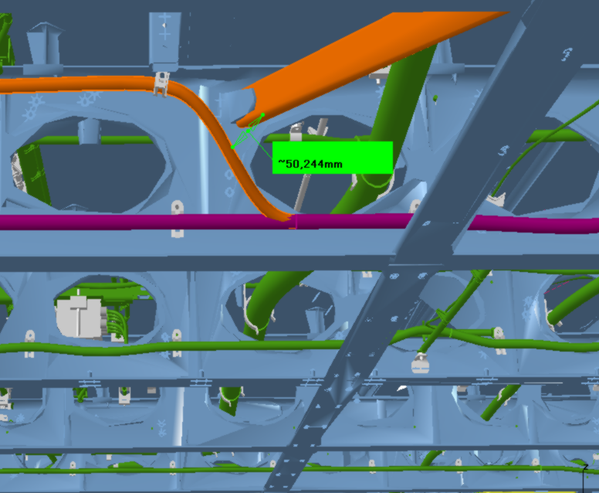
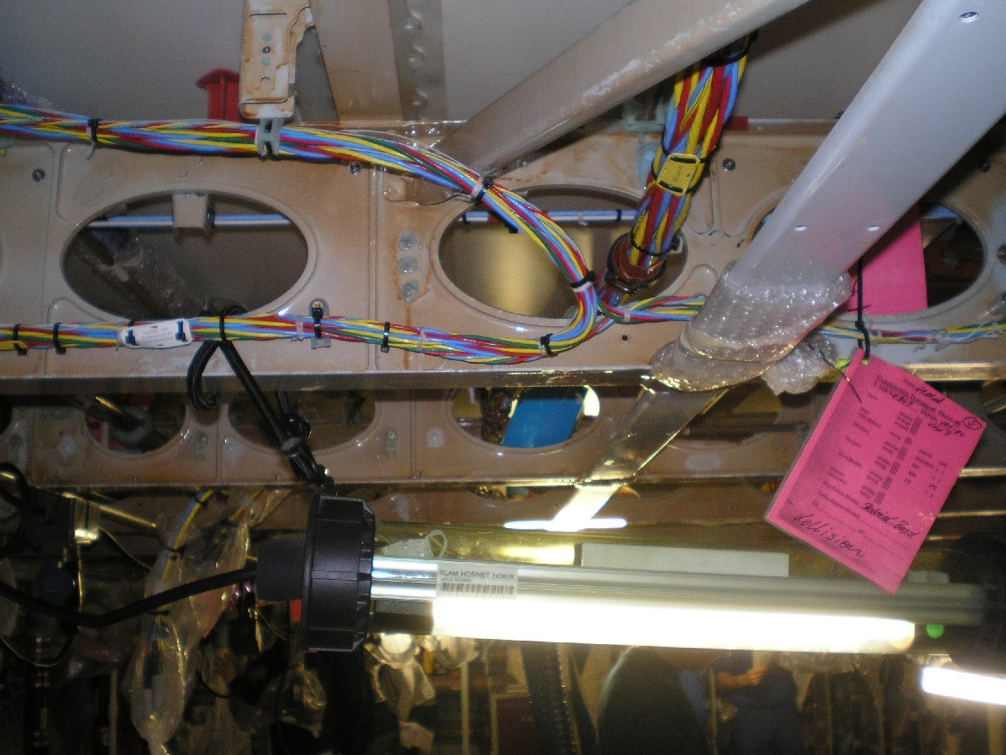
Airbus use cases in ModelWriter
We decided to concentrate on some problematics related to System Installation
SIDP is used (under Non Disclosure agreement) as a use case
We primarily focus on Electrical, Water Waste, and Fuel Systems
System installation:
obeys to some Regulations
is specified by some rules/requirements/principles
the design and the manufactured product are checked against these rules

Slide 33
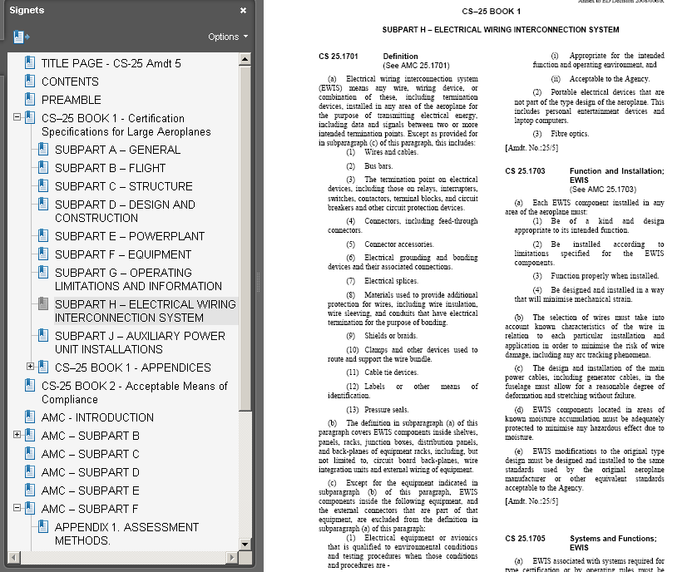
Certification Specification – CS 25 (EASA)
CS 25.1701 Definition
(a) Electrical wiring interconnection system (EWIS) means any wire, wiring device, or combination of these, including termination devices, installed in any area of the aeroplane for the purpose of transmitting electrical energy, including data and signals between two or more intended termination points (...)

Slide 34
System Installation Design Principles

Slide 35
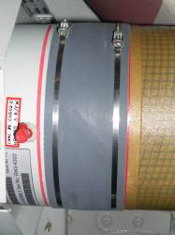
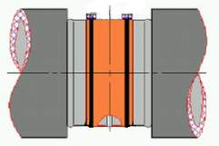
Rule traceability & design check
Traceability
Check

Slide 36
Problem statement & objectives
Model and manage the design rules: since SIDP (design principles) are todays kinds of natural language requirements and explanations:
not all the rules can be directly formalized in a way to be used to verify the design
rules are spread over various products/programs
rules evolve
rules are complex artefacts made of text and picture and tables….
This problem is the one we have been considering primarily in the scope of ModelWriter, trying to define a rule model and knowledge base
Enable mapping between rule model and design model, in order to automate identification of conflicts between rules and design, and then automate analysis of the impact of changes in rules or in design.
This 2d objective is not a primary one for Airbus in ModelWriter because of the challenge of mapping 3D design models to the BOM… and because lack of skills and data in the context of the project
BUT to be consider to make the system amenable for formal analysis / & we welcome Ford Otosan Use case

Slide 37
Problem statement & objectives
(1) Manage rules/design principles and improve traceability
Easier search/retrieval of rules | save costs/time by supporting DP consultation / retrieval in accordance to the needs
Easier change impact analysis at rules level | save DP updating costs/time avoid non-compliance of design caused by DP updating lead time
Easier traceability between artefacts (BOM DB, design models, CAD models…) | keep traceability from upstream regulations to requirements and to downstream design models
(2) Automate identification of design conflicts against rules
Easier consistency checking of the design (CAD) data | Save time to retrieve applicable rules avoid non-compliance of design wrt rules

Slide 38
Solutions explored in MW
 |  | 1 | 2 | 3 | 4
Use a Component taxonomy (~BOM) as a reference to annotate rules (rules as Text part / Taxonomy as Model part) | MW synch. mechanism + Semantic Annotation tool (WP2+WP4) | + | + | - | -
Extend first approach to annotate other artefacts/models | MW synch. mechanism + Semantic Annotation tool (WP2+WP3+WP4) | + | - | + | +
Add semantics to Component description (ontology) to enable reasoning | MW synch. mechanism + reasoning mechanisms dedicated to synchronization (WP4+WP3) | + | + | +
Model rules written in natural language by formalizing them in Description Logic and vice versa / Ability to dynamically update the Component ontology and apply some checks on design rules | MW synch. mechanism + Semantic parsing/DL generation (WP4+WP2) |  | + | + | +
Model rules written in natural language by formalizing the rules in relational logic | MW synch. mechanism + MW model (WP4+WP3) |  |  | + | +
1=Rule retrieval, 2=Rule change, 3= Traceability, 4=Design check

Slide 39
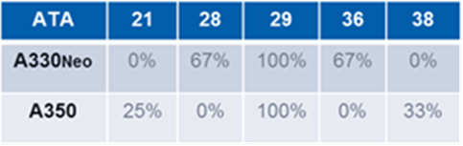
Some Facts, Impact, and KPIs
Scope of 900 documents
ATA : disciplines: 6179 ATA number (chapter+subchapters)
Today (@MW project start) duration of documents updating process: ~ 6 months
900 to 1000 potential users per Program or 200 per Derivatives
Total number of rules? ~3000 rules (TBC)
Expected Rule coverage in the use cases? ~50%
966 rewritten rules (quality to be checked)
Coming from 7 different SIDP docs (SIDP 92 is missing in the table below that shows the coverage of rewritten rules wrt to SIDP docs)

Slide 40
Back-up Slides
UC-FR-03 - Synchronization of Regulation Documentation with a Design Rule Repository
Anne MONCEAUX
Airbus Group Innovation

Slide 41
Rule data representation
Object Property
RUID
Rule
Component
RuleID
Rule primary object
Variant
SubClasses
…
coupling
equipment
others
Data Properties
Classes

Slide 42
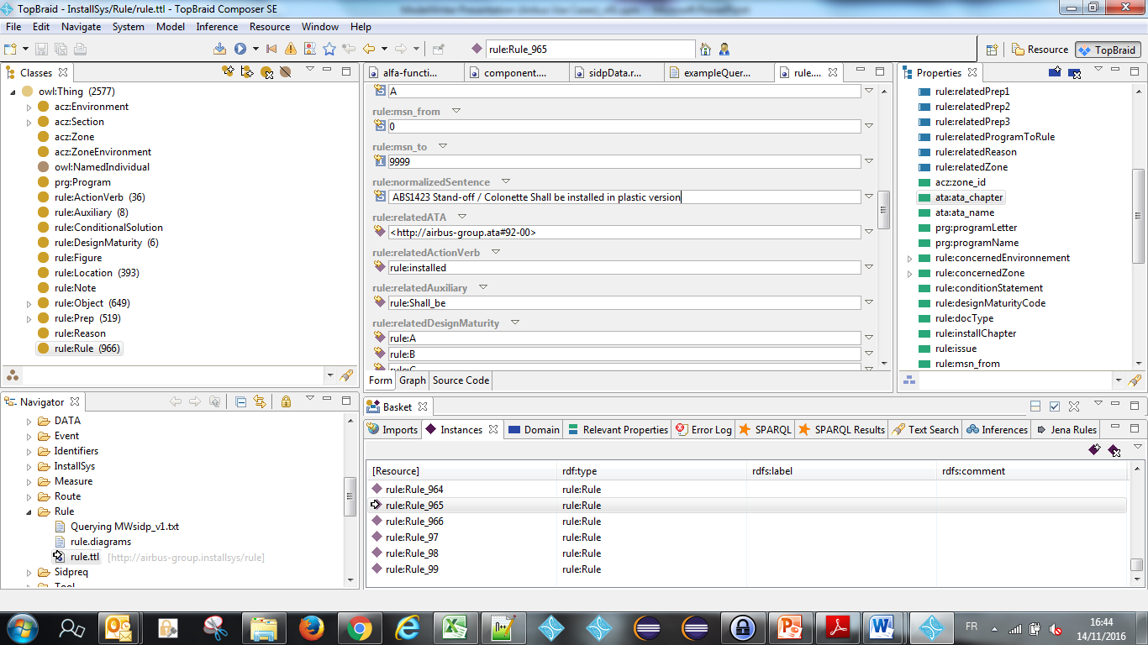
Rules (DB with normalized sentences)

Slide 43
BOM, Component taxonomy and ontology
ObjectProperties
Component
Assembly
“Structural_Element”
subClassOf
“Bracket”
Physical component
Attachment device
“Fastener”
“Pclamp”
Clamp
AnnotationProperties
Rdfs:label
“Assembly”
Skos:prefLabel
P-Clamp
P-Clamp NSA5516

Slide 44
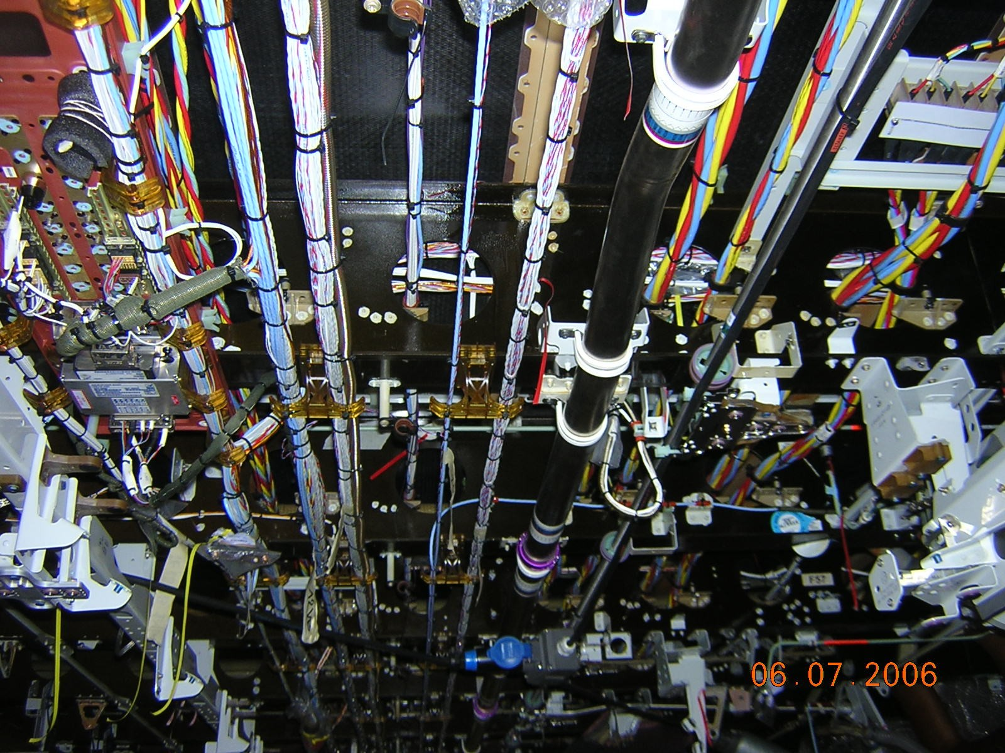
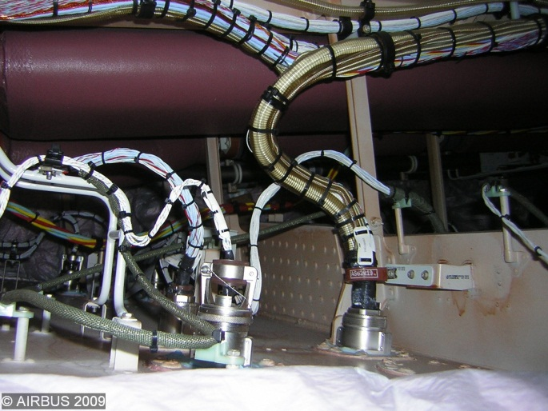
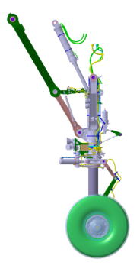
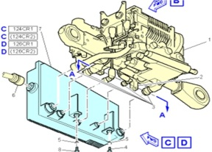
Ex. Electrical wiring interconnection system (EWIS)
Mainly: Aircraft electrical common installation (ATA92)
1
3
11
12
6
8
4, 5
10
13
But also: part of Systems equipment wiring:
Power distribution centers wiring
External wiring of equipment
Wiring of equipment not qualified to appropriate standards e.g. EUROCAE ED-14 / RTCA DO-160
cf CS 25.1701(b)&(c)

Slide 45
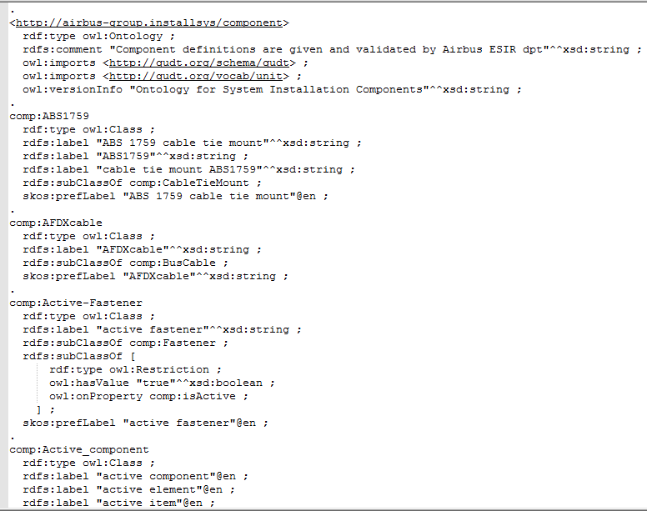
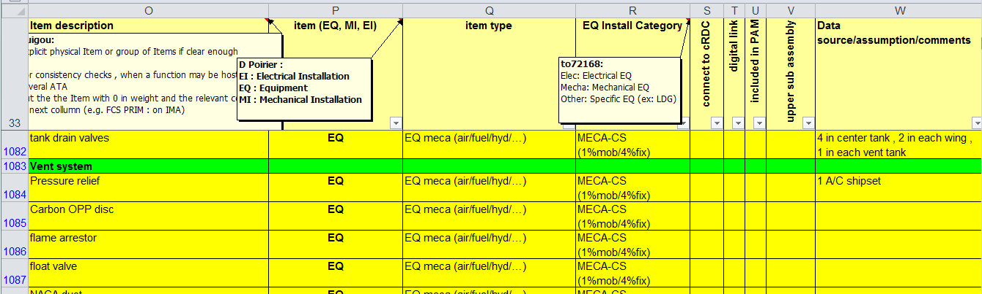
BOM, Component taxonomy and ontology

Slide 46
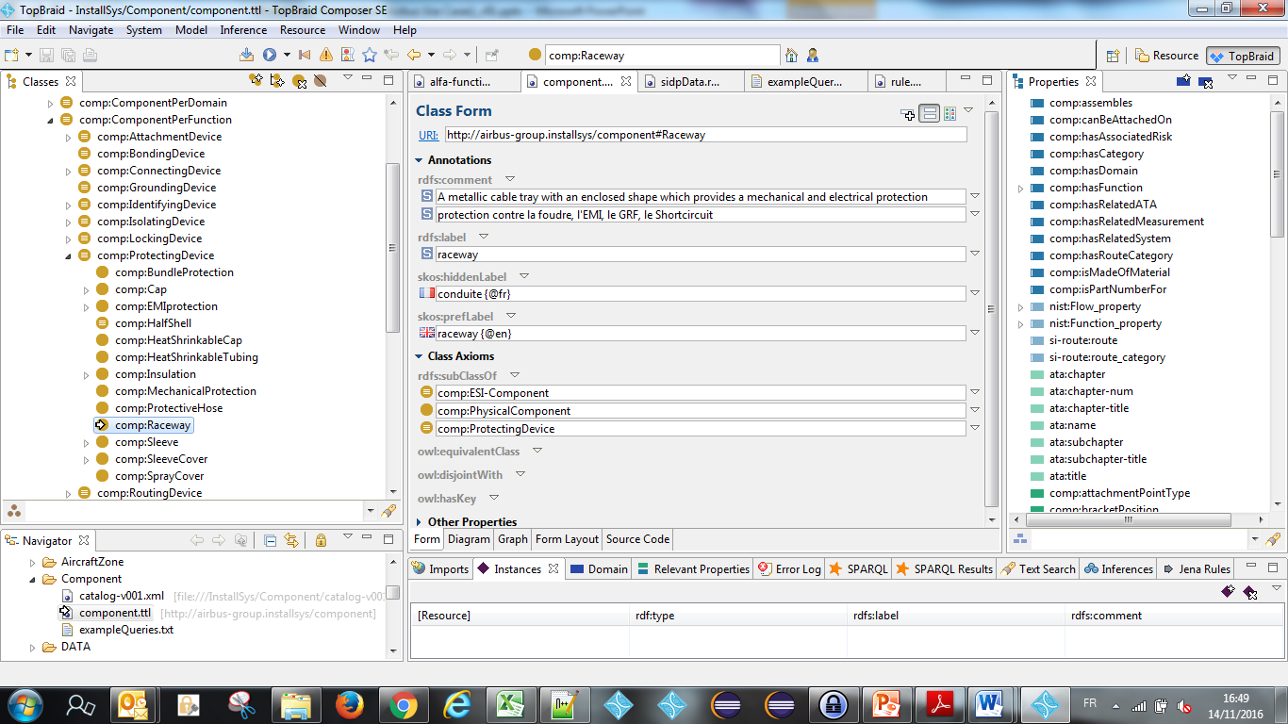
Component ontology

Slide 47
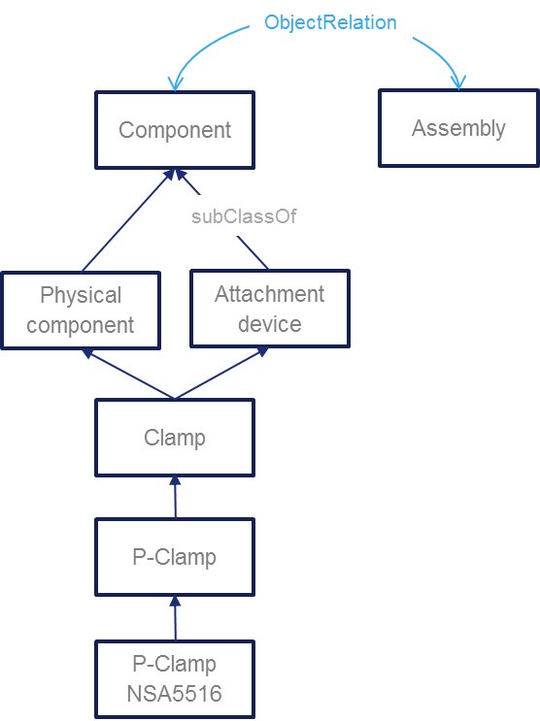
UC-FR-04 - Component taxonomy and ontology (Model part)
“P-clamp NSA5516 can be fixed on X with Y”
“Physical component”
“Standard reference”
NLP Parsing uses this taxonomy. Labels + assumptions such as a physical component may be referred to using its name or its reference or both concatenated
Inference rule: a rule applying to a component type (Attachment device) applies to its subtypes (P-clamp)
Document display : when searching rules applying to a component type (P-Camp) → retrieve and display rules applying to super-types

Slide 48
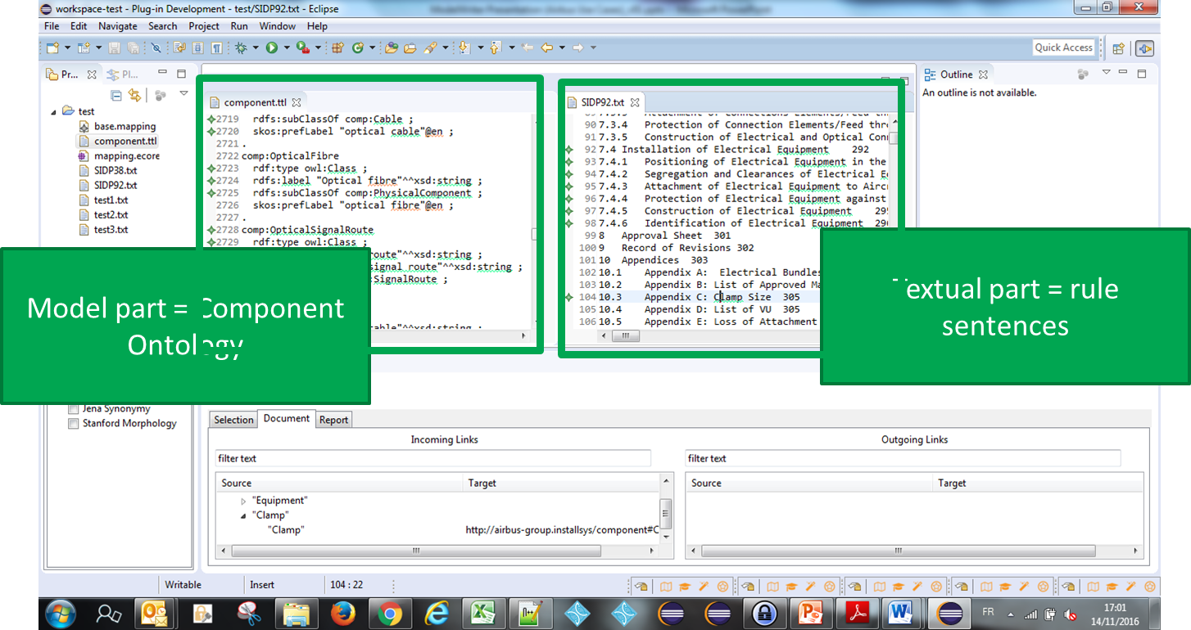
On going tests = Use a Component taxonomy (~BOM) as a reference to annotate rules (rules as Text part / Taxonomy as Model part) - WP2+WP4 Core
Status 1st iteration*: synchronizing the SIDP KB content and rule text part
Experimented using WP2 parser + WP4 MW Core
1st iteration = using individual DP normalized sentences”
2d iteration = using NL DP inside documents
*

Slide 49
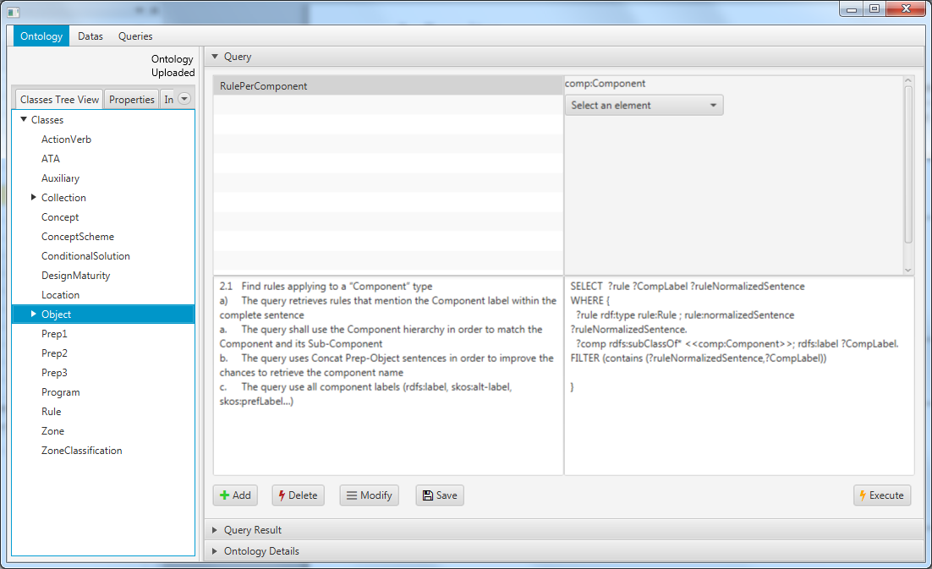
SPARQL queries
Status : model based queries specification
Preliminary study with Loria (Text to RDF)
1 internship on RDFizer and Query management

Slide 50
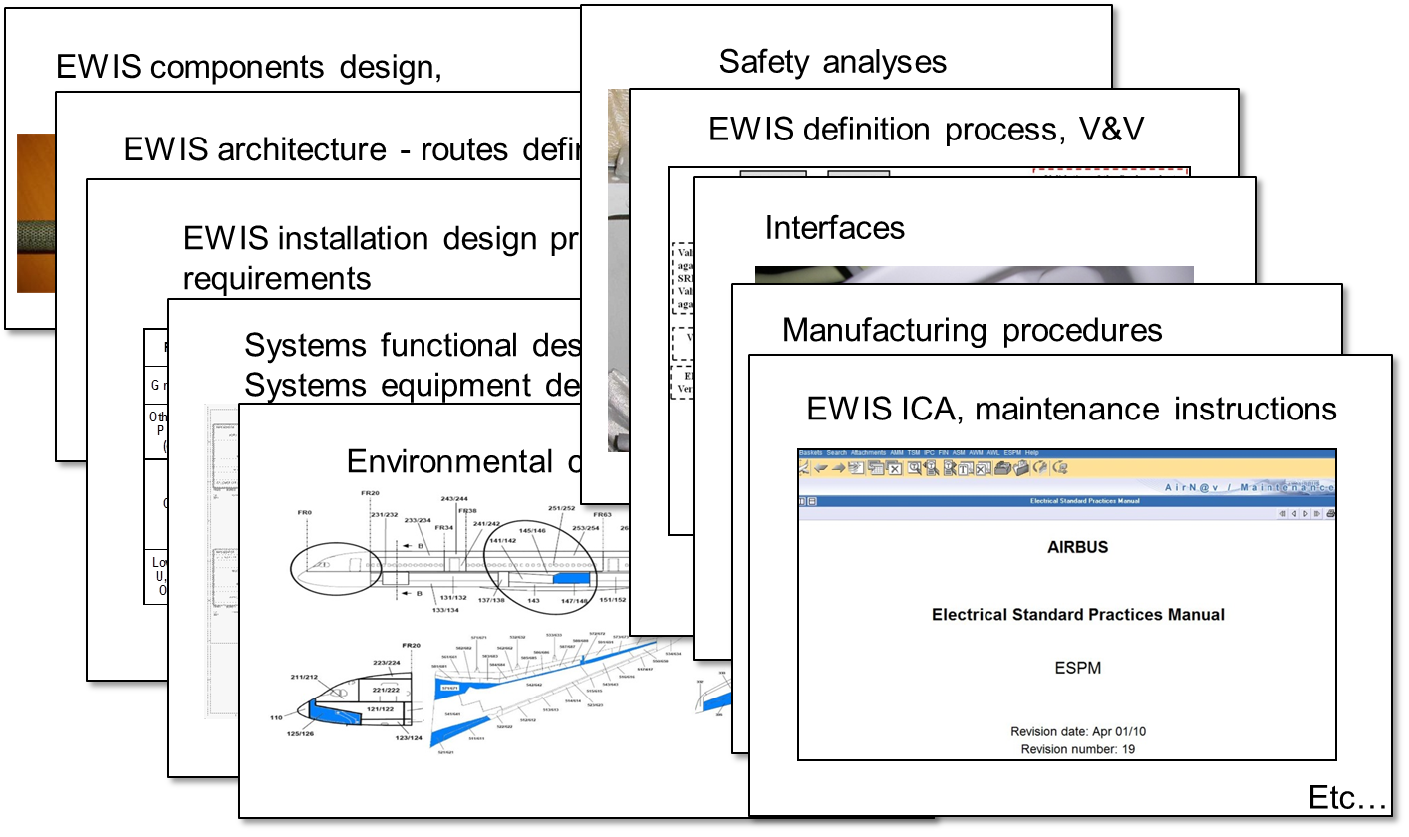
Ex. A/C wiring - Traceability with other artefacts

Slide 51
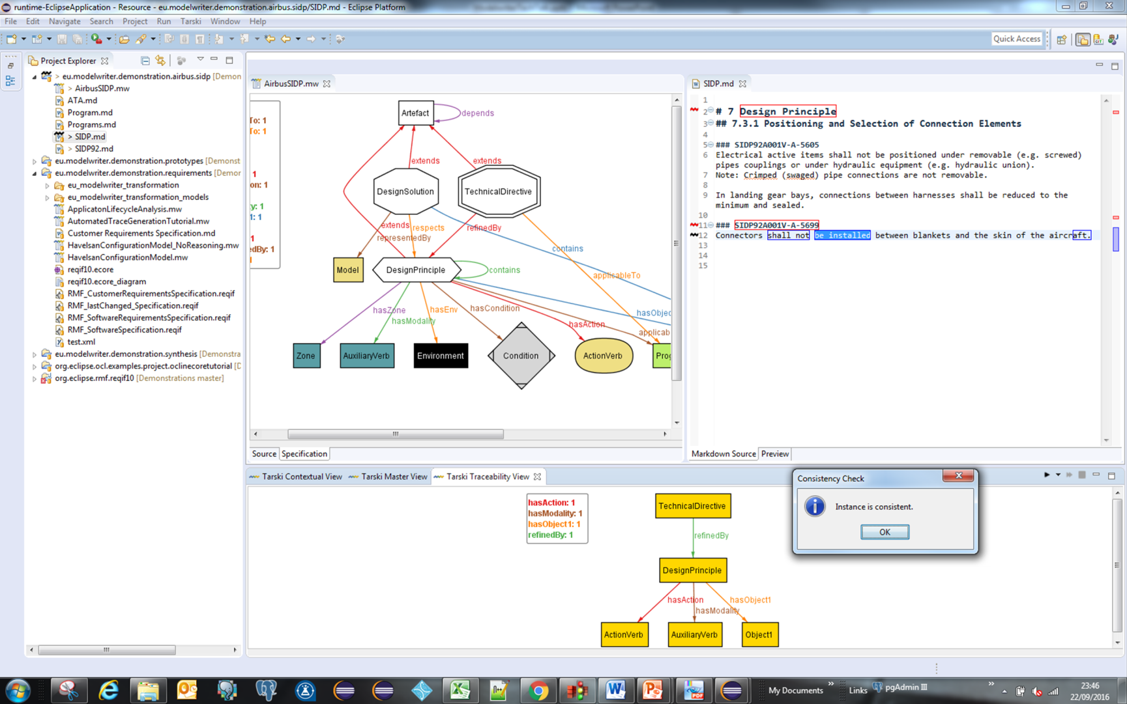
On going tests = Extend first approach to annotate other artefacts/models and reason about them - WP2+WP3+WP4 Core
Status : synchronizing the SIDP domain artefacts
Test using WP3 Tarsky
Model part = SIDP traceability model
Textual part = DP NL text in documents
*

Slide 52
Thank you for your attention! Any question ?

